Slide 1
DC Device Characterisation Using Arduino Micro
R. Sheehan 27 – 11 - 2020

Slide 2
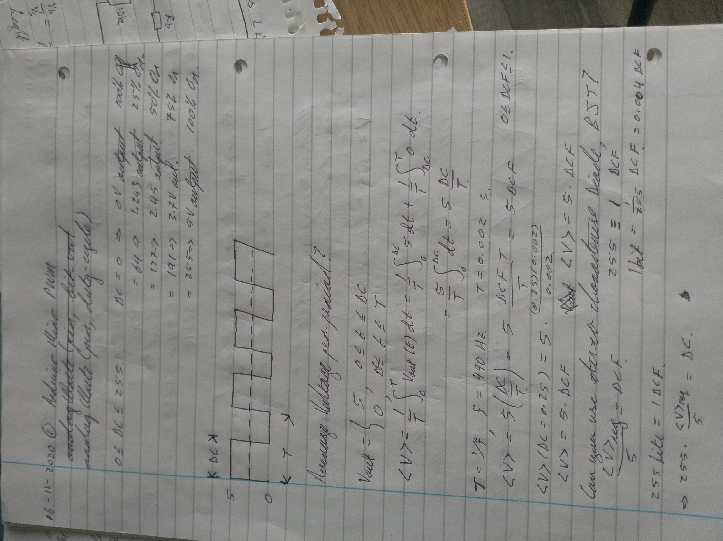
PWM -> DC
Arduino Micro contains several digital output pins that enable PWM The pulse duty cycle can altered to produce an average DC signal over pulse period However, to ensure it is a true DC signal a low-pass filter is required on the output Choose R = 1 kΩ, C = 100 μF, 3dB BW ~ 5Hz You now have a DC source 0 < V < 5V Accurate to within 10ish mV

Slide 3
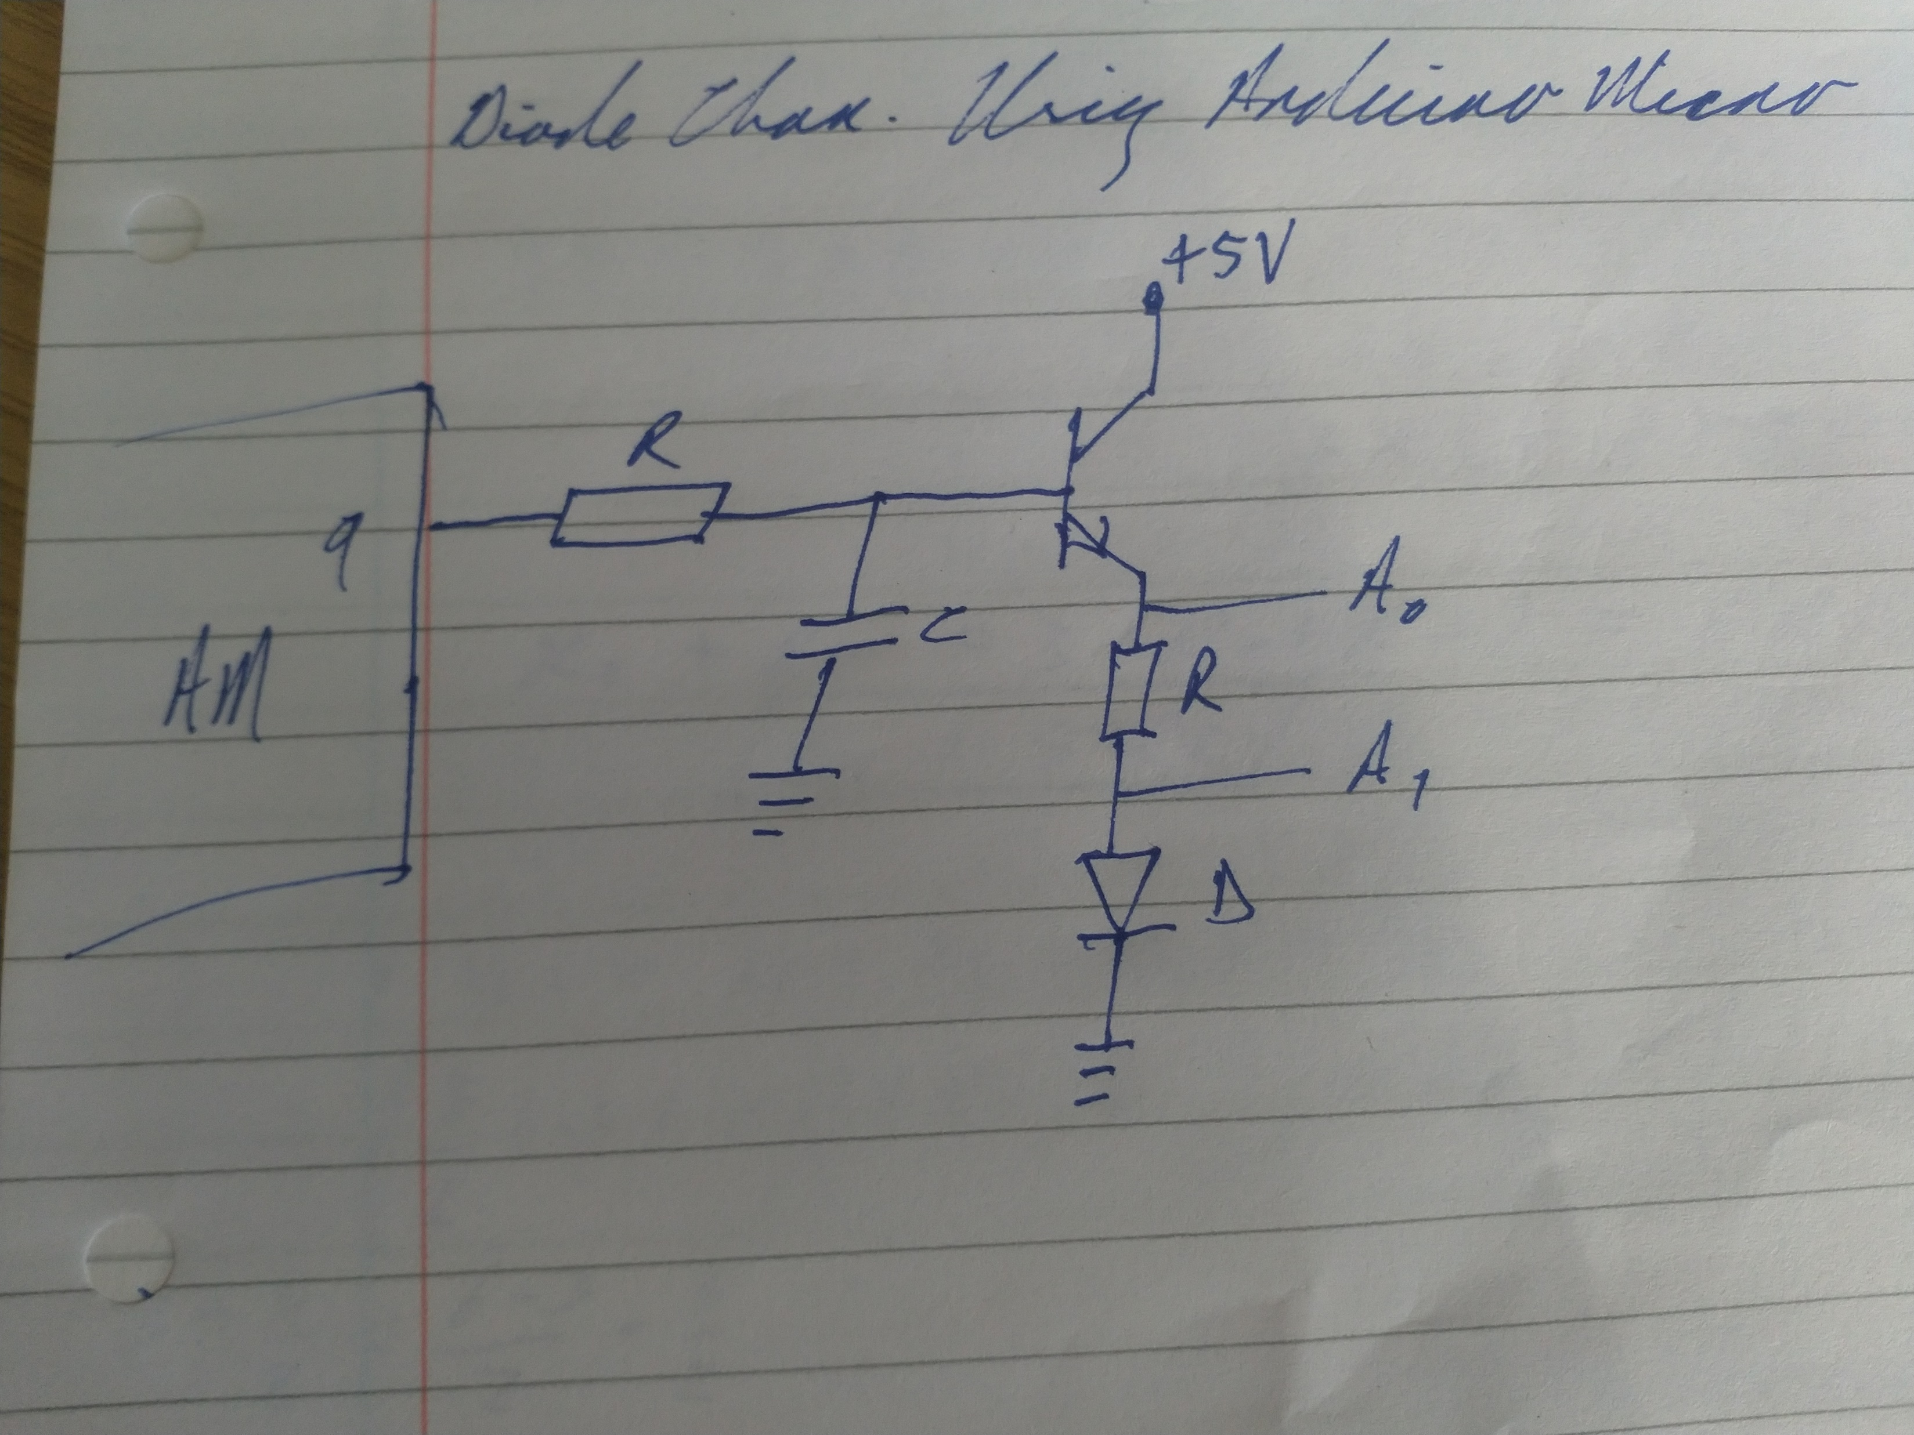
Diode Characterisation
Possible to implement DC sources on AM
+5V is supplied by AM, no external
power-supply needed
Current amplifiers required to ensure sufficient current is available.
Measurement of biases enabled through Analog Inputs A0 – A5 on board

Slide 4
Diode Characterisation
Possible to implement DC sources on AM
+5V is supplied by AM, no external
power-supply needed
Current amplifiers required to ensure sufficient current is available.
Measurement of biases enabled through Analog Inputs A0 – A5 on board
Results as expected for R = 10 Ω and diode FR1001

Slide 5
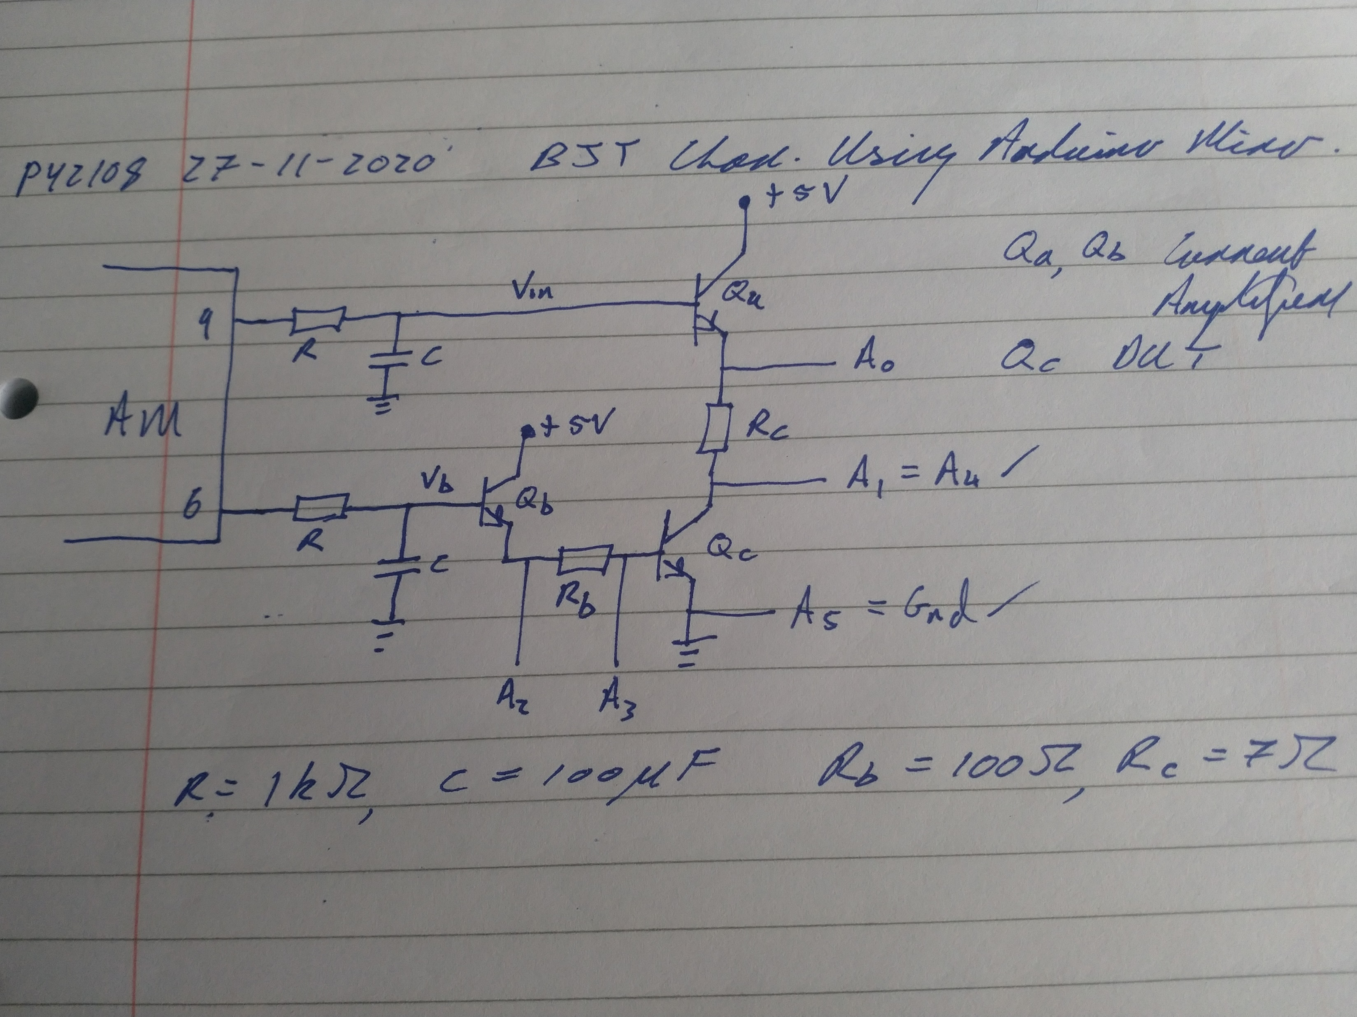
BJT Characterisation
Possible to implement two DC sources on AM
Fix Vb while sweeping Vin
+5V is supplied by AM, no external
power-supply needed
Current amplifiers Qa, Qb required to ensure sufficient current is available.
Measurement of biases enabled through Analog Inputs A0 – A5 on board

Slide 6
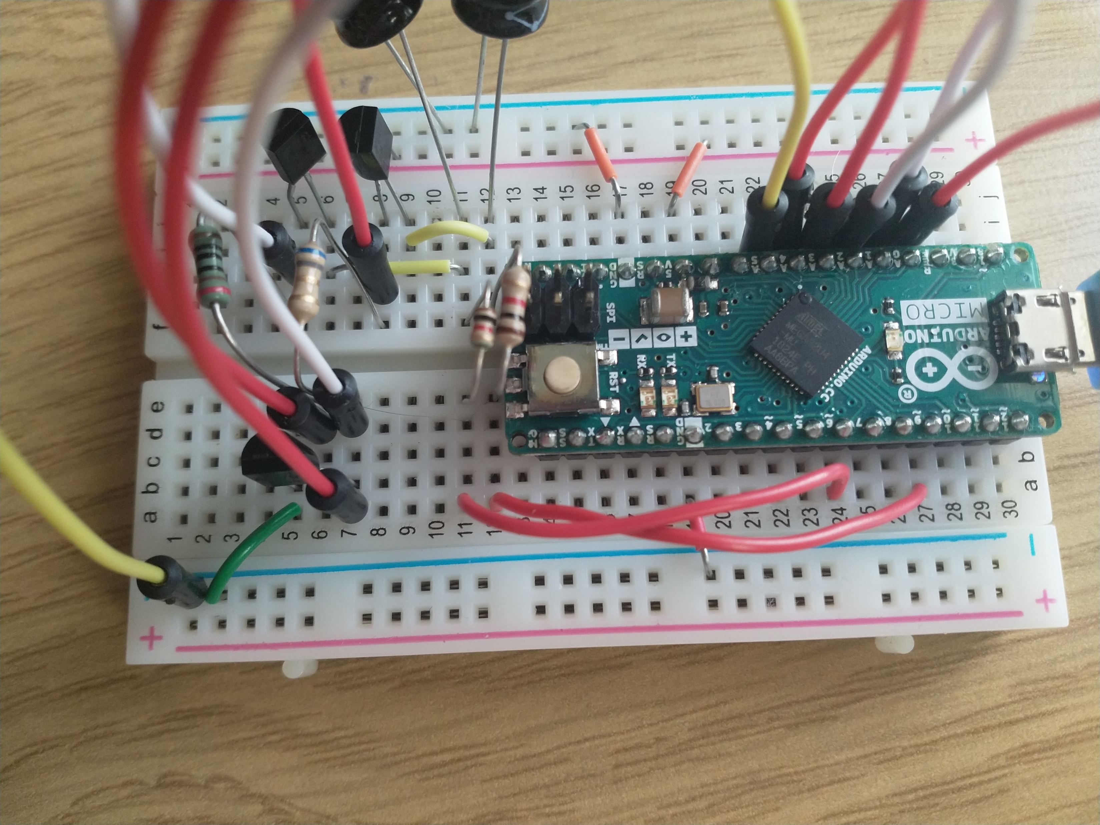
BJT Characterisation
Possible to implement two DC sources on AM
Fix Vb while sweeping Vin
+5V is supplied by AM, no external
power-supply needed
Current amplifiers Qa, Qb required to ensure sufficient current is available. Measurement of biases enabled through Analog Inputs A0 – A5 on board

Slide 7
BJT Characterisation
Possible to implement two DC sources on AM
Fix Vb while sweeping Vin
+5V is supplied by AM, no external
power-supply needed
Current amplifiers Qa, Qb required to ensure sufficient current is available. Results are as expected

